Slide 1
MongoDB Training
Nilap Shah
(MongoDB Certified DBA + Developer)
https://www.linkedin.com/in/nilap-shah-8b6780a/
Mobile : 9537047334 (WhatsApp)

Slide 2
Data Modeling
MongoDB is having flexible document structure.
While designing data model. You always needs to
Consider how data will be inserted, Updated and retrieved with best performance
If your design is not good → no database can deliver effective results to you

Slide 3
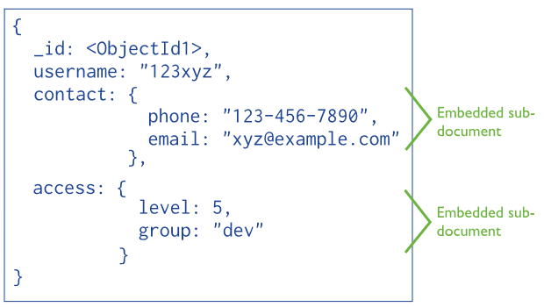
Embedded / Denormalized Data

Slide 4
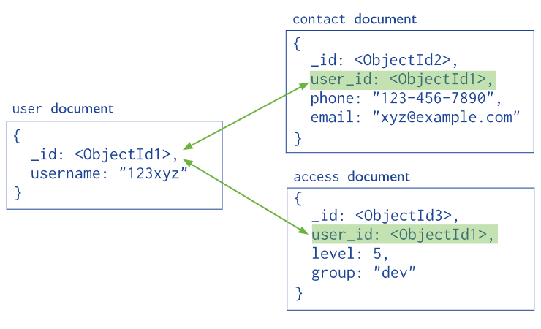
References / Normalized / linking

Slide 5
Performance
If your application uses most recent data then you can choose capped collection for the same
If not you can create proper document structure and also add appropriate indexes on collections
Create number of Indexes wisely. Only create it what requires. More number of indexes will degrade the write operations

Slide 6
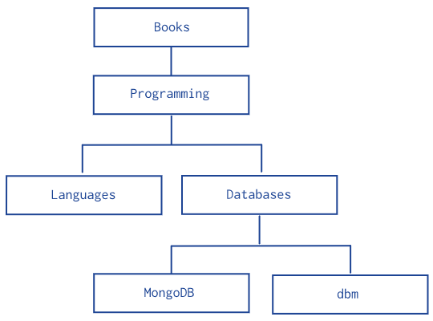
Model Structure with Parents - Tree

Slide 7
Model Structure with Children - Tree

Slide 8
Array of Ancestors - Tree

Slide 9
Tree Structures with Nested Sets

Slide 10
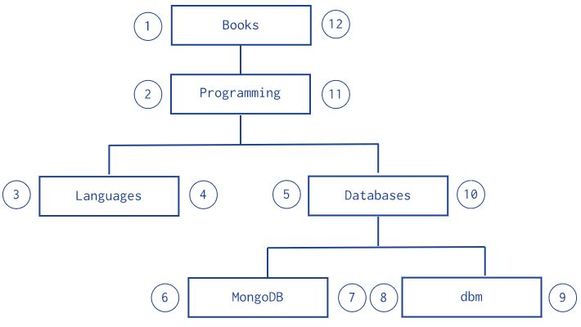
Tree Structures with Materialized Paths

Slide 11
Nilap Shah (MongoDB Trainer)
Linked in Profile (Mobile-9537047334)
https://www.linkedin.com/in/nilap-shah-8b6780a/

